Slide 1

HSB Daily WIP Monitoring Report
User Guide Document
Hartalega Holdings Bhd
Prepared by Pang Yik Siu
Version 1.0
18th Feb, 2019

Slide 2
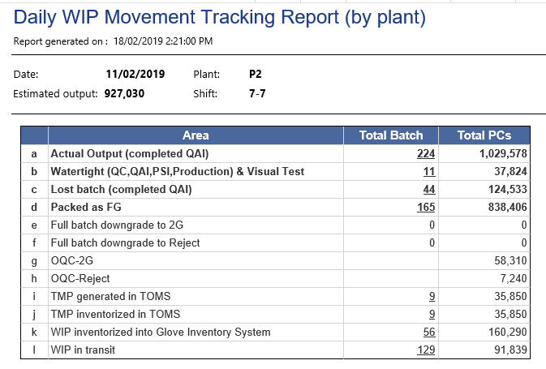
System Functionalities – Daily WIP Monitoring Report
 | Area | Description
a. | Actual Output (completed QAI) | Online and offline batch card that completed QAI Online: Hourly Batch Card Offline: Print Normal Batch Card
b. | Watertight (QC,QAI,PSI,Production) | Watertight batch card that completed QAI
c. | Lost batch (Completed QAI) | Lost batch card that completed QAI
d. | Packed as FG | Batch card completed final pack
e. | Full batch downgrade to 2G | Batch card downgrade to second grade glove completely under QC module
f. | Full batch downgrade to Reject | Batch card downgrade to reject glove completely under QC module
g. | OQC-2G | Sorted out 2G glove pieces during QC scanning
h. | OQC-Reject | Sorted out rejected glove pieces during QC scanning
i. | TMP generated in TOMS | Batch card registered in TOMS system
j. | TMP inventorized in TOMS | Batch card registered in TOMS system without scan out and scan into pallets
k. | WIP inventorized in GIS | Batch card scan in to GIS without scan out
l. | WIP in transit | Batch card not found in area below but not packed Full batch downgrade to 2G/Reject Full batch downgrade to 2G/Reject Non-SP pending OQC/PT Registered as TMP Stored into Glove Inventory
Input
Output
In transit

Slide 3
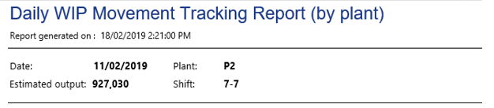
System Functionalities – Daily WIP Monitoring Report
Report Parameters
Date: batch card date
Shift : 7-7 or 12-12
Plant: plant selection (P2,P3,P4,P5,P6)
Estimated Output
Get glove output from OEE data (OEE_Data.TargetOutput)
If selected ‘Date’ is not process in OEE backend, it will get output from production line in particular plant (ProductionLine.Speed * 24)

Slide 4
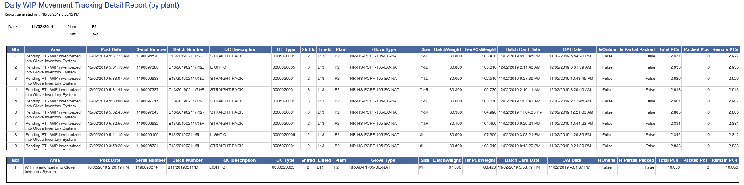
System Functionalities – Daily WIP Monitoring Detailed Report
Table 1
Detailed report show the record breakdown by batch card details
Screen shot (Table 1) showed ‘PT’ batch card in Glove Inventory System.
Screen shot (Table 2) show remaining batch card in Glove Inventory System.
Table 2

Slide 5
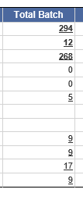
System Functionalities – Daily WIP Monitoring Detailed Report
Detailed report will show batch card breakdown information for each area by clicking hyperlink at (Total Batch)
It will get the latest posted date for particular area
Total PCs information is purely from QAI output
Fields displayed included:
1. | Area | 10. | Size | 19. | Packed PCs
2. | Post Date | 11. | Tier Side | 20. | Remain PCs
3. | Serial Number | 12. | BatchWeight
4. | Batch Number | 13. | TenPCsWeight
5. | QC Description | 14. | Batch Card Date
6. | ShiftId | 15. | QC Type
7. | LineId | 16. | QAI Date
8. | Plant | 17. | IsOnline
9. | Glove Type | 18. | Total PCs

Slide 6
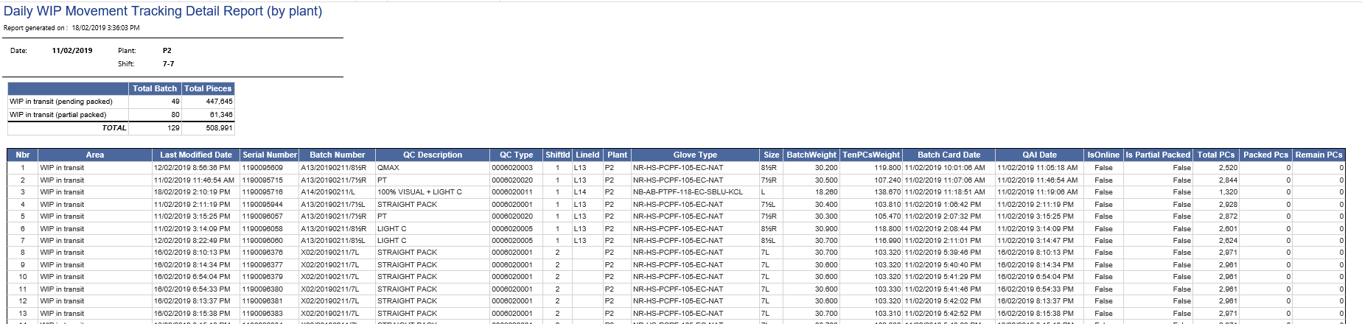
System Functionalities – Daily WIP Monitoring Detailed Report
Table 1
Table 2
Screen above show ‘WIP in transit’ batch card.
First table is showing Total batch with partial packed or pending packed
Second table is showing batch card details

Slide 7
THANK YOU
Thank you

